Slide 1
ETL
Musadaq Mansoor

Slide 2
Introduction
ETL stands for Extract, Transform, Load.
It refers to a process in data management that involves extracting data from various sources, transforming it into a format that is suitable for analysis and reporting, and loading it into a destination system, such as a data warehouse or a database.

Slide 3
Extract
The first part of an ETL process involves extracting the data from the source systems.
The extraction step is crucial in the ETL process because it is the foundation upon which the rest of the process is built.
Ensuring that the data is extracted accurately and efficiently is key to the success of the entire ETL process.
Most data warehousing projects consolidate data from different source systems.

Slide 4

Transform
The transform stage refers to the processes that occur after the data has been extracted from its source and before it is loaded into its destination.
The main purpose of the transform stage is to prepare the data for its intended use by cleaning, modifying, and transforming it into a suitable format.

Slide 5
Transform
Selecting only certain columns to load (or selecting null columns not to load).
Example:
if the source data has three columns (also called attributes), for example, roll_no, age, and salary, then the extraction may take only roll_no and salary.
Similarly, the extraction mechanism may ignore all those records where salary is not present (salary = null).
Transposing
Splitting

Slide 6
Transform
Translating coded values (e.g., if the source system stores 1 for male and 2 for female, but the warehouse stores M for male and F for female)
Encoding free-form values (e.g., mapping "Male" to "1")
Deriving a newly calculated value (e.g., sale_amount = qty * unit_price) Sorting
Joining data from multiple sources (e.g., lookup, merge) and deduplicating the data
Aggregation

Slide 7
Load
The load phase loads the data into the end target, usually the data warehouse (DW). Depending on the requirements of the organization, this process varies widely.
Some data warehouses may overwrite existing information.
Other DW (or even other parts of the same DW) may add new data in a historicized form, for example, hourly.
To understand this, consider a DW that is required to maintain sales records of the last year. Then, the DW will overwrite any data that is older than a year with newer data. However, the entry of data for anyone-year window will be made in a historicized manner.

Slide 8
ETL Life Cycle
The typical real-life ETL cycle consists of the following execution steps:
1. Cycle initiation
2. Build reference data
3. Extract (from sources)
4. Validate
5. Transform (clean, apply business rules, check for data integrity, create aggregates or disaggregates)
6. Stage (load into staging tables, if used)
7. Audit reports (for example, on compliance with business rules. Also, in case of failure, helps to diagnose/repair)
8. Publish (to target tables)
9. Archive
10. Clean up

Slide 9
Challenges
ETL processes can involve considerable complexity, and significant operational problems can occur with improperly designed ETL systems.
The range of data values or data quality in an operational system may exceed the expectations of designers at the time validation and transformation rules are specified.
Data profiling (Data profiling is the process of examining a dataset in order to understand its characteristics and quality. It involves analyzing the data to identify patterns, trends, inconsistencies, and other characteristics that can help to better understand the data and its potential uses)

Slide 10
PETL
https://petl.readthedocs.io/en/v0.16/

Slide 11
Extract Examples

Slide 12
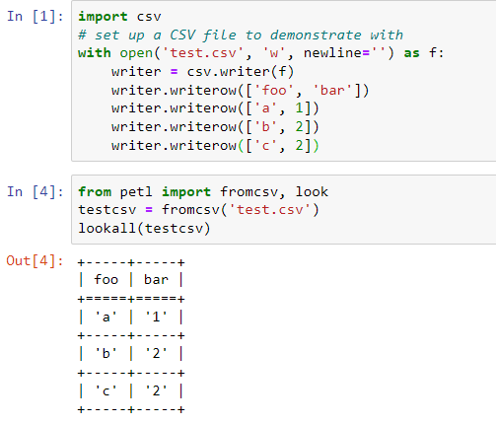
CSV

Slide 13
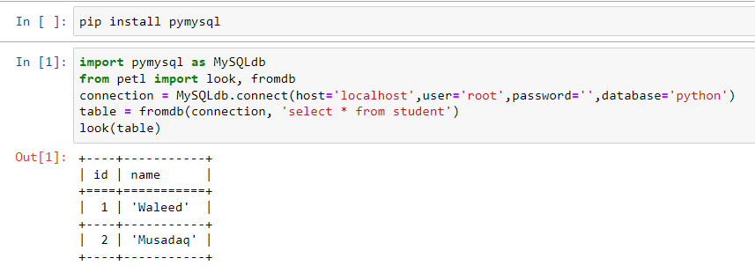
MySql

Slide 14
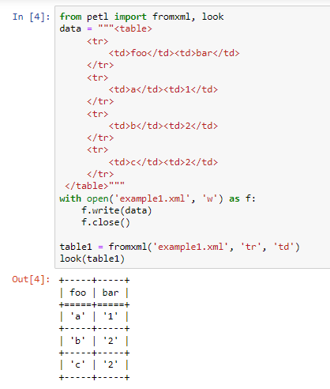
xml

Slide 15
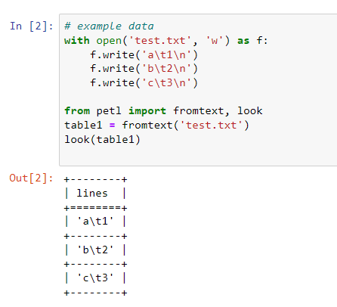
txt

Slide 16
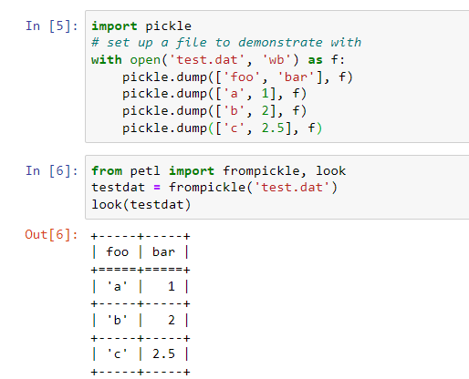
dat

Slide 17
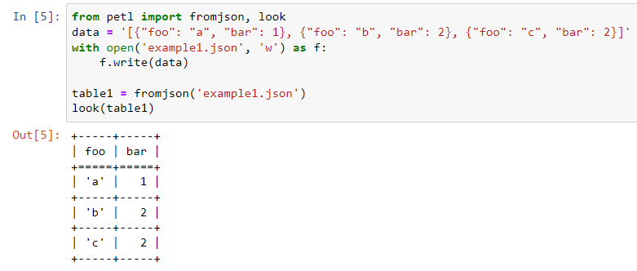
json

Slide 18
Transform

Slide 19
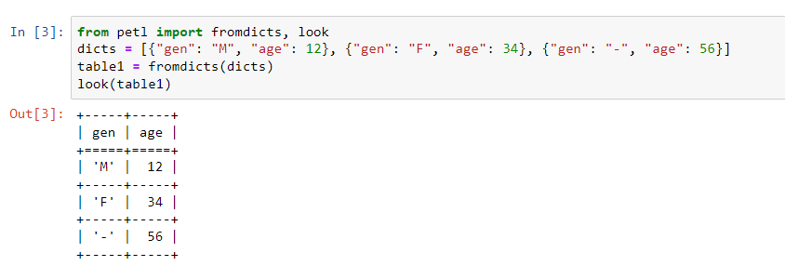
Rename

Slide 20
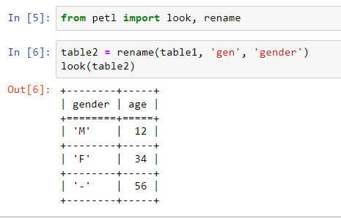
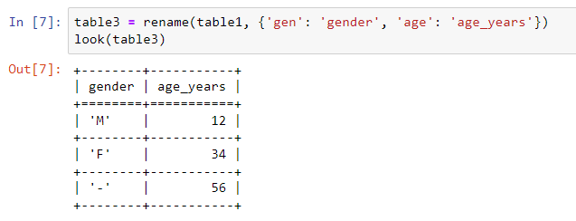
Rename

Slide 21
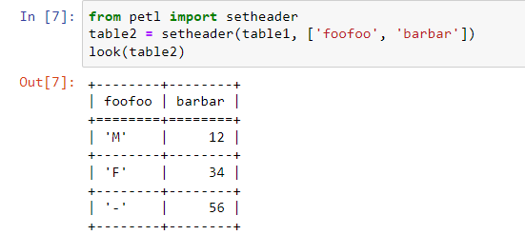
setheader

Slide 22
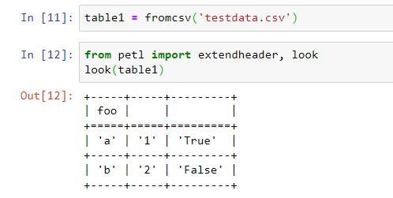
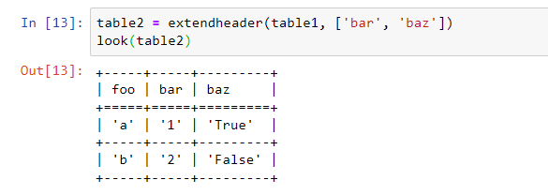
extendheader

Slide 23
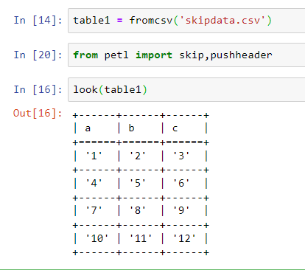
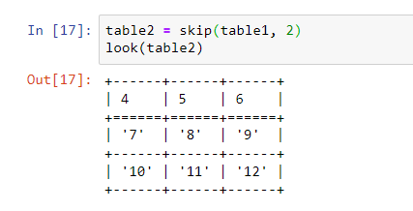
skipdata

Slide 24
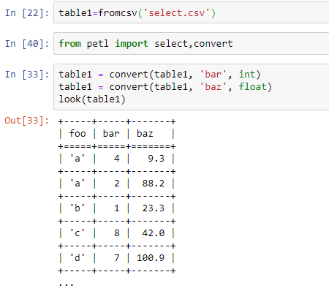
convert

Slide 25
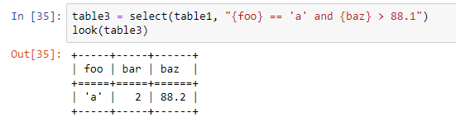
select

Slide 26
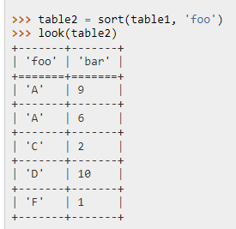
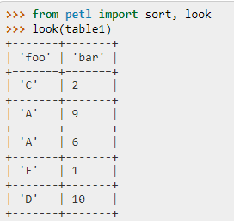
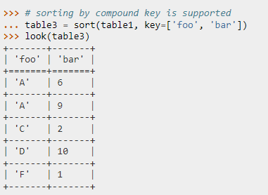
sort

Slide 27
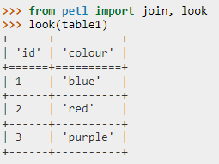
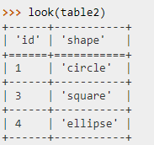
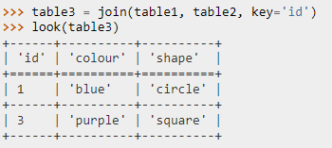
join

Slide 28
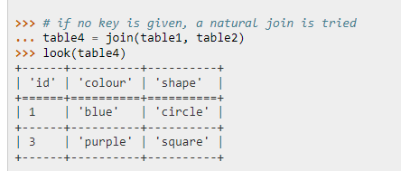
join

Slide 29
Load

Slide 30
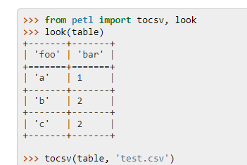
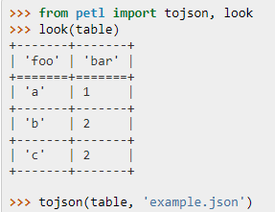
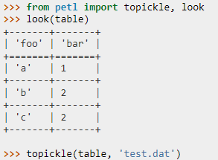
Some load functions

